Slide 1

Homeostasis
Introduction

Slide 2
Homeostasis
Definition
Homeostasis is the process whereby the body’s internal environment is maintained within within normal tolerance limits (steady state)
  Dynamic equilibrium
  Input and output of materials and energy is balanced

Slide 3
The internal environment
An adult’s body contains about 14 L of tissue fluid (also known as interstitial fluid).
Tissue fluid:
  bathes ALL cells
  represents the cell’s immediate environment
  provides optimum conditions for cell function

Slide 4
Examples of properties of tissue fluid which must be maintained in homeostatic balance
body temperature
blood pressure
fluid concentrations (osmotic pressure, diffusion and electrochemical gradients)
acidity (pH)
the concentration of nutrients (e.g. glucose), metabolic wastes and gases

Slide 5
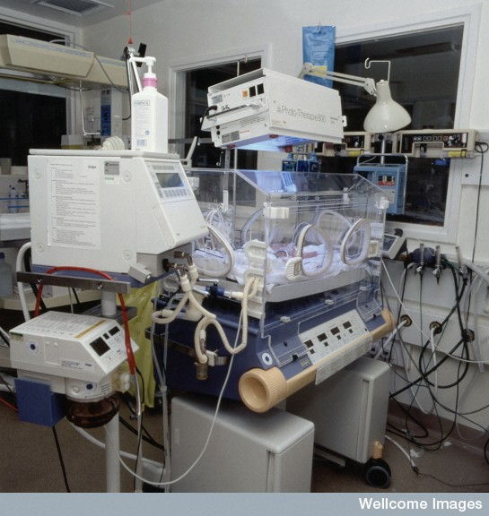
Intensive care
An incubator plus monitoring and life support equipment in a special care baby unit helps premature babies, or new-born babies with life-threatening conditions, to establish homeostasis

Slide 6
Tolerance limits
The range of conditions in which the body can function are referred to as its tolerance limits.
If conditions change beyond the tolerance limits and the body is out of homeostasis for a prolonged period
  body systems cannot function properly

Slide 7
Body temperature
Normal range
Death
Below tolerance limit
37˚C
Above tolerance limit
Death
Hypothermia
Hyperthermia/heatstroke
Blood pressure
Death
120/80 mm Hg
Death
Shock
Hypertension
Blood glucose
Death
3.5 – 8 mmol/L
Death
Hypoglycemia
Hyperglycemia/ Diabetes

Slide 8
Steady state control mechanisms
If our body temperature gets too high we sweat and this returns our temperature to a safe level.
If we get too cold we shiver and this produces extra body heat.
The body processes responsible for maintaining homeostatic balance are called steady state control mechanisms.

Slide 9
Examples of steady state control mechanisms
Steady state control process | Maintains homeostatic balance of
Sweating/shivering Vasodilation Vasoconstriction | Body temperature
Breathing rate | Oxygen & carbon dioxide levels pH
Cardiac output | Most homeostatic functions
Kidney function | Getting rid of wastes Fluid balance pH

Slide 10
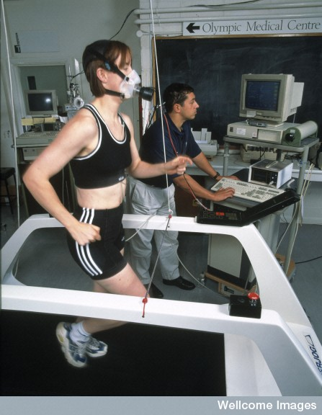
During exercise we breathe harder and our heart beats faster to maintain the correct balance of oxygen and carbon dioxide.
. Female athlete having cardiovascular fitness tested
Wellcome Library, London

Slide 11
The feedback model
Steady state control processes are regulated by feedback mechanisms
Feedback mechanisms are self-regulating control processes (i.e. we do not control them consciously) because the response continually modifies the stimulus.
These feedback processes are referred to as feedback loops.

Slide 12
Negative feedback and homeostasis
Homeostasis is maintained by means of negative feedback systems
(or steady state control systems)
i.e. the response neutralises or reverses the original stimulus.
Controlled by both endocrine and nervous system

Slide 13
Negative feedback loop
Change in the environment
Detects the change
Stimulus
Receptor
Modulator
Feedback
Control centre
processes information from receptor
sends information to effector
Achieved because original stimulus has been changed by the response
Response
Effector
Counteracts the effect of the stimulus
Carries out a response

Slide 14
Negative feedback loop
Core temperature
> 37˚C
Thermoreceptor
Stimulus
Receptor
Thermoregulatory centre in the hypothalamus
Core temperature
lowered to 37˚C
Feedback
Modulator
Response
Effector
Sweat secretion
Sweat glands

Slide 15
Positive feedback
Does not play a role in homoeostasis
The response to a stimulus is intensified
The most common example is the release of oxytocin from the posterior pituitary gland during childbirth
Important in controlling body processes that must be completed quickly

Slide 16
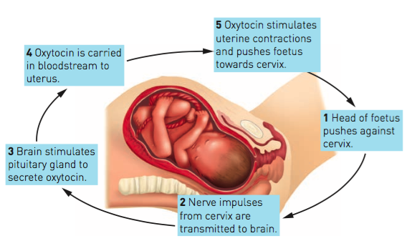

Slide 17
Conscious responses to environmental change
We can respond consciously to external change in order to maintain homeostatic balance
e.g. if we feel too hot we can choose to move away from the heat source or remove clothing.

